Slide 1



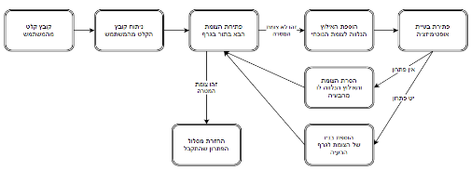
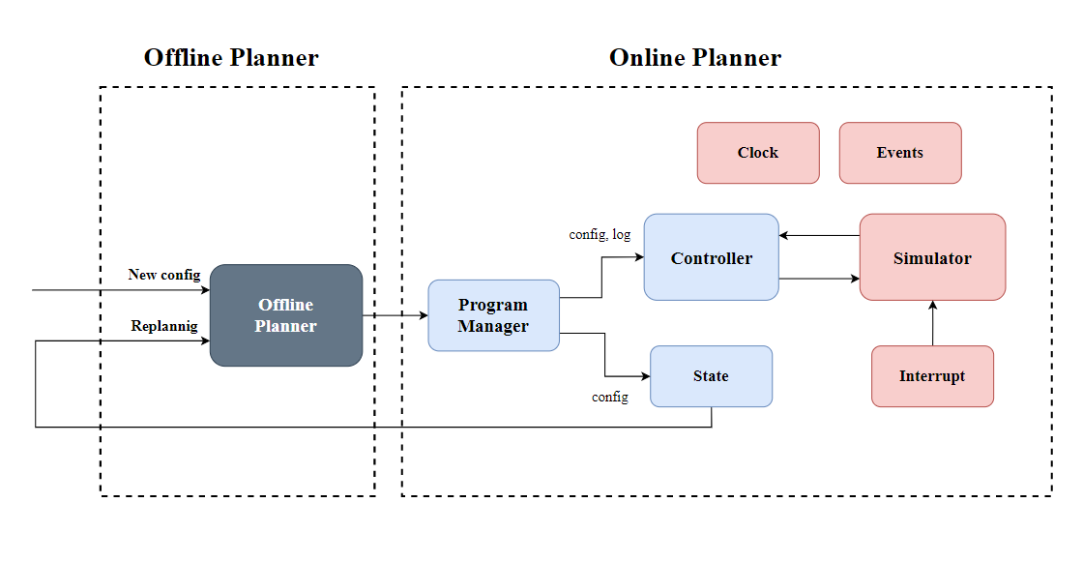

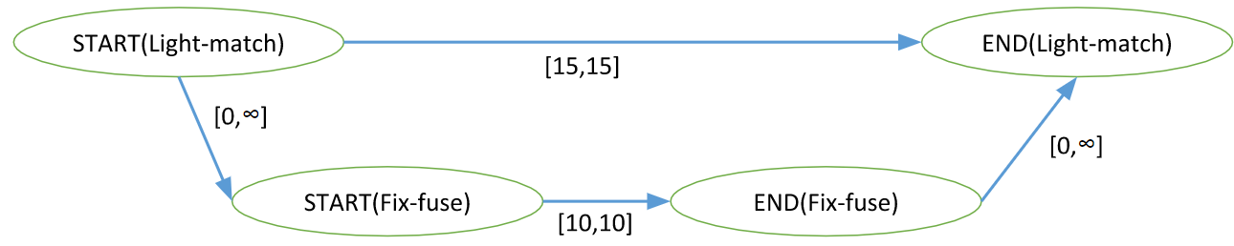
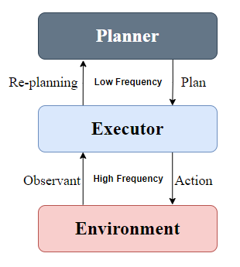
Online Algorithm for Takeoff and Landing Management
Yoav Cohen and Hodaya Cohen-Adiv, Supervised by Ayal Taitler
Introduction
Planner
Block Diagram
An airport has a lot of operations everyday.
Multiple planes that are simultaneously take off and land.
Operations that depend on other operations.
Unexpected problems create conflicts and may change the day plan.
Airport management is done with a day plan which is executed in REAL TIME.
Planner – Block Diagran
Offline Planner – is the Offline Algorithm.Program manager – is the linking chain between the offline algorithm and the online algorithm. Responsible for creating the different modules and their connections.Controller – is the control tower. The controller decides on the next actions that will be sent to the environment for execution. The main data structure that it uses is a STN graph:The offline output is a STN graph in a table configuration. The controller transforms the table to an a-cyclic directed graph.
The Offline Planner input is a config file and the output is a STN graph.
STN GRAPH
The planning problem under time constrains is an optimization problem that finds the optimal solution.
The constrains are represented in data structure called STN graph.
Airport
Project Goal
Online output with interrupts:
Creating an online algorithm for managing takeoffs and landings
Our algorithm ran the offline plan while dealing with real-time malfunctions and changes.
The algorithm must decide whether the program can run with the different constraints or whether re-planning is needed.
STN example
Real-Time Interrupts
The interrupts module create random disorders which delay actions in real-time. This module is part of the Environment block.
The delays can be resolved in one of two ways:
Stretching the STN graph - meaning that the delay causes a time shifting for all the graph, but the problem is still feasible.
Replanning of the problem – the problem isn’t feasible, and we need to plan a new STN graph with the new delay.
Online output with replanning:
Challenges
New config file
New offline log file
Planning with times and constraints in real time.
Feedback from the online algorithm to the offline algorithm.
New online log file
General Schema
Our Algorithm
The Executor dispatches actions to the Environment.
For each action we verify:
All ancestors are done.
The next sate of the environment is feasible.
The action is ready.
If one of the verifications failed the algorithm will start replanning the problem.
Future Work
Add more types of interrupts to simulate a more realistic world in a simulation.
Add a GUI - make the system inactive to the user with which he will be able to track the planes and lanes in real-time.
The Planner is the Offline Algorithm.
The Executor is the Online Algorithm.
The Environment is the testing module that simulates an airport with interrupts in real-time.

